Slide 1

Intrinsic images in the wild
- The fast and the curious
Saumya shah (20171193)
Aniket mohanty (20171150)
Soumyasis gun (20171002)
Mentor ta : karandeep singh juneja
Repo : https://github.com/DefUs3r/Intrinsic-Image-Decomposition

Slide 2
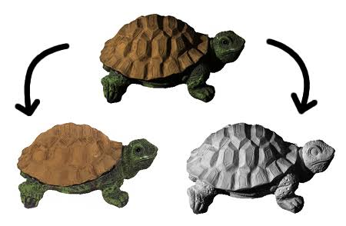
Aim
Intrinsic images are a decomposition defined by image reflectance and shading.
Answering questions like :
What effect is the lighting having, irrespective of surface materials?
What is the surface reflectance, irrespective of lighting?
REFLECTANCE
SHADING

Slide 3
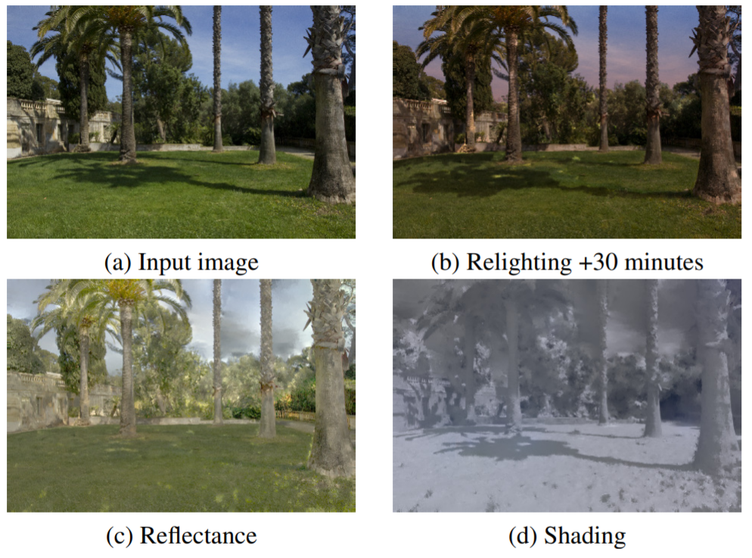
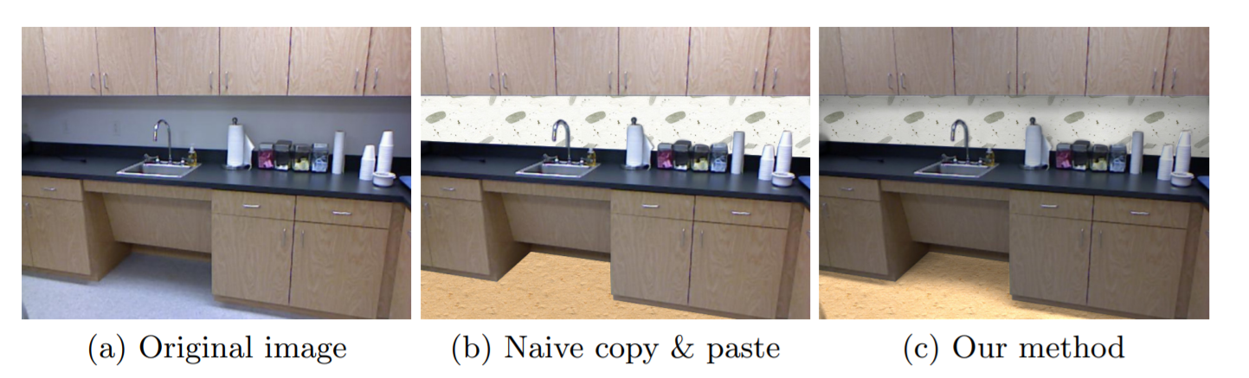
Motivation
Image Relighting
Intrinsic images along with cast shadows information, can be used for image relighting.
It can also be used for texture composition that preserves the lighting information.
Texture composition

Slide 4

Intrinsic image decomposition
Intrinsic image decomposition gives output as reflectance (R) and shading (S).
Very under-constrained problem.
Infinitely many possible reflectance and shading layers that multiply to explain an input image.
Need to find reflectance layer R* and shading layer S* that is most likely under the probability distribution $p.$
$R^{∗},S^{∗}= \begin{aligned} \\ argmin \\ R,S\end{aligned}{ p\left(R,S \right| I)}$
such that $I_{i}^{c}=R_{i}^{c}∙S_{i}^{c}$ for every image pixel $i$ per channel c.

Slide 5
Motivation for Constraints from prior works
Pixels that are nearby, and that have similar chromaticity or intensity, also have similar reflectance.
Reflectances are piecewise-constant
[Land and McCann 1971; Liao et al. 2013; Barron and Malik 2013b].
Reflectances are sampled from a sparse set
[Omer and Werman 2004; Gehler et al. 2011; Shen and Yeo 2011].
Certain shading values are a priori more likely than others
[Barron and Malik 2013b].
Neighboring pixels have similar shading
[Garces et al. 2012].
Shading is grayscale, or the same color as the light source.

Slide 6
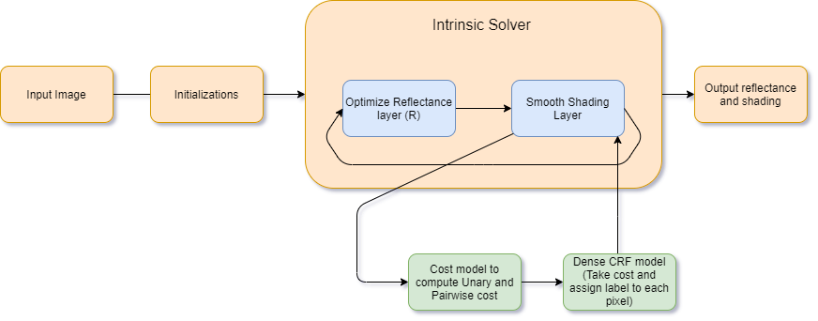
Algorithm overview

Slide 7
Initialization
Convert RGB image to IRG space (intensity, red chromaticity, green chromaticity)
Run k-means on this for 20 clusters and store the centers as recflectances in $R$
Run k-means on this for 20 clusters and store the centers as recflectances in 𝑅
Project image back to RGB space

Slide 8
Algorithm overview

Slide 9
Solver Stages
Stage 1:
Assign each pixel a reflectance selected from R
Stage 2:
Optimizing the set of reflectances R itself to improve shading intensity S.

Slide 10
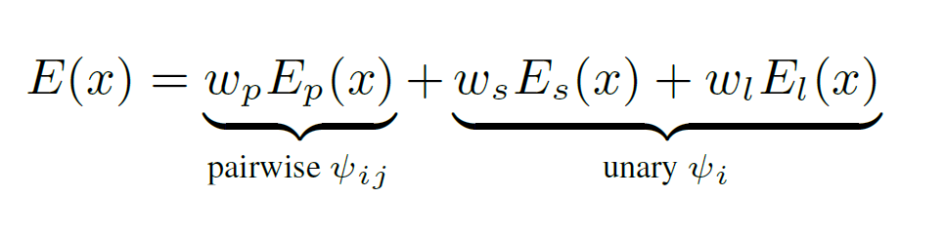
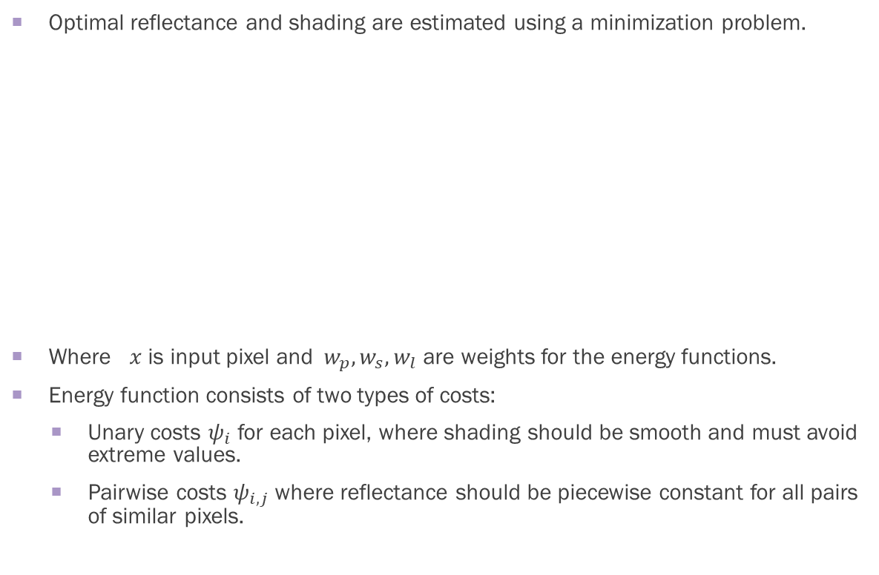
Stage 1 : Framing objective function
Optimal reflectance and shading are estimated using a minimization problem.
Where $x$ is input pixel and${ w}_{p},w_{s},w_{l}$ are weights for the energy functions.
Energy function consists of two types of costs:
Unary costs $ψ_{i}$ for each pixel, where shading should be smooth and must avoid extreme values.
Pairwise costs $ψ_{i,j}$ where reflectance should be piecewise constant for all pairs of similar pixels.

Slide 11
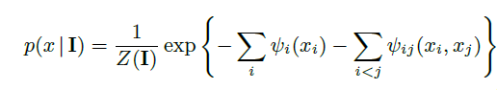
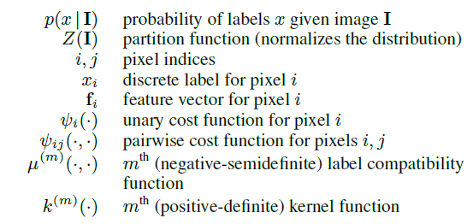
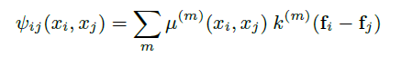
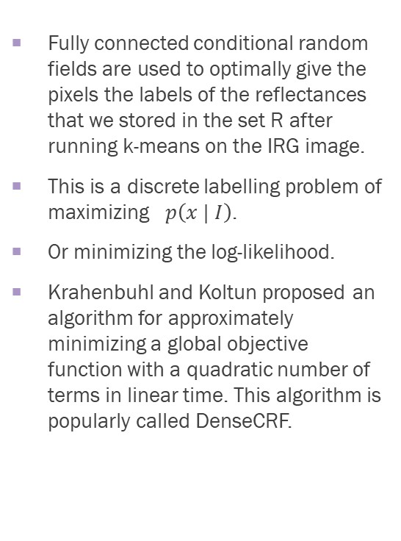
How is the optimization done ?
Fully connected conditional random fields are used to optimally give the pixels the labels of the reflectances that we stored in the set R after running k-means on the IRG image.
This is a discrete labelling problem of maximizing $p\left(x | I\right)$.
Or minimizing the log-likelihood.
Krahenbuhl and Koltun proposed an algorithm for approximately minimizing a global objective function with a quadratic number of terms in linear time. This algorithm is popularly called DenseCRF.

Slide 12
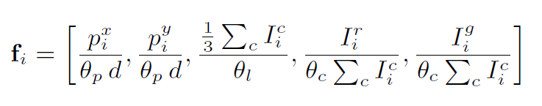
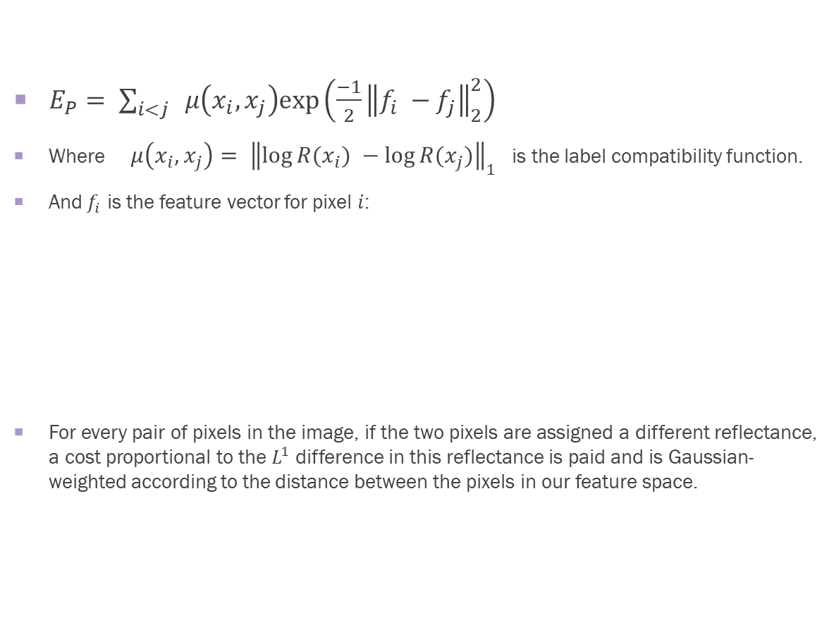

Reflectance energy $E_{P}$
$E_{P}= \sum_{i<j}{ μ\left(x_{i},x_{j}\right)exp⁡\left(\frac{−1}{2}{\left\|f_{i} −f_{j}\right\|}_{2}^{2}\right)}$
Where $μ\left(x_{i},x_{j}\right)= {\left\|\log{R(x_{i})} −\log{R(x_{j})}\right\|}_{1}$ is the label compatibility function.
And $f_{i}$ is the feature vector for pixel $i$:
For every pair of pixels in the image, if the two pixels are assigned a different reflectance, a cost proportional to the $L^{1}$ difference in this reflectance is paid and is Gaussian-weighted according to the distance between the pixels in our feature space.

Slide 13
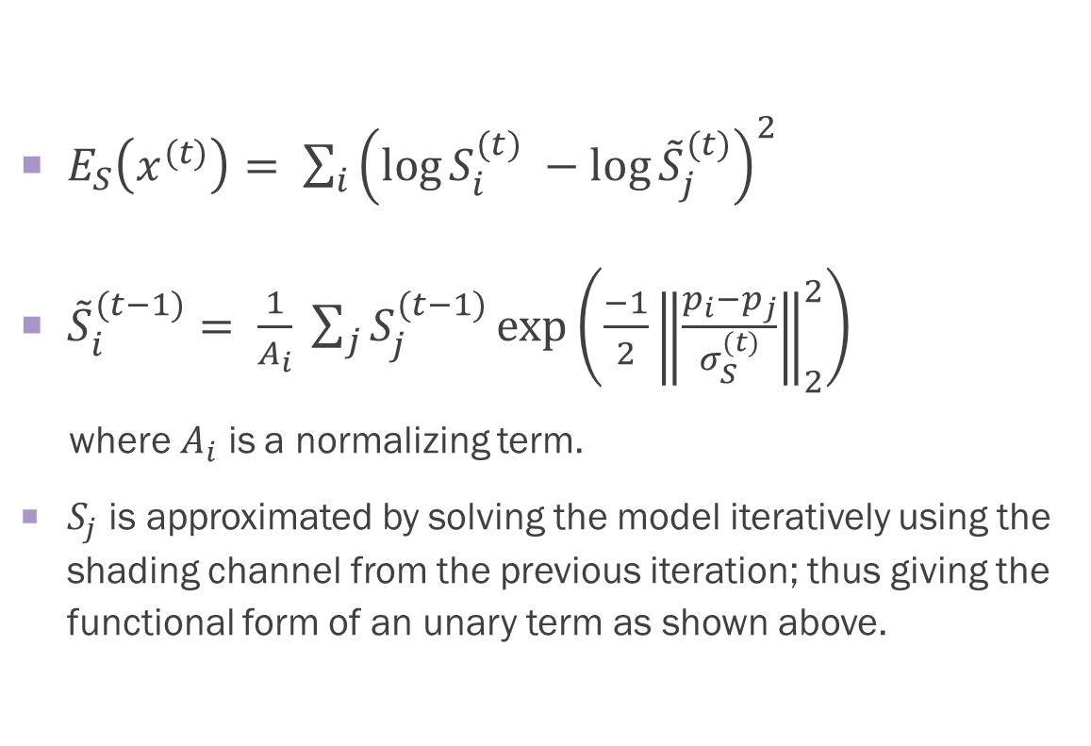

Shading smoothness $E_{S}$
$E_{S}\left(x^{(t)}\right)= \sum_{i}{{\left(\log{S_{i}^{(t)}} −\log{{\tilde{S}}_{j}^{(t)}}\right)}^{2}}$
${\tilde{S}}_{i}^{(t−1)}= \frac{1}{A_{i}} \sum_{j}{S_{j}^{(t−1)}}\exp\left(\frac{−1}{2}{\left\|\frac{p_{i}−p_{j}}{σ_{S}^{(t)}}\right\|}_{2}^{2}\right)$
where $A_{i}$ is a normalizing term.
$S_{j}$ is approximated by solving the model iteratively using the shading channel from the previous iteration; thus giving the functional form of an unary term as shown above.

Slide 14
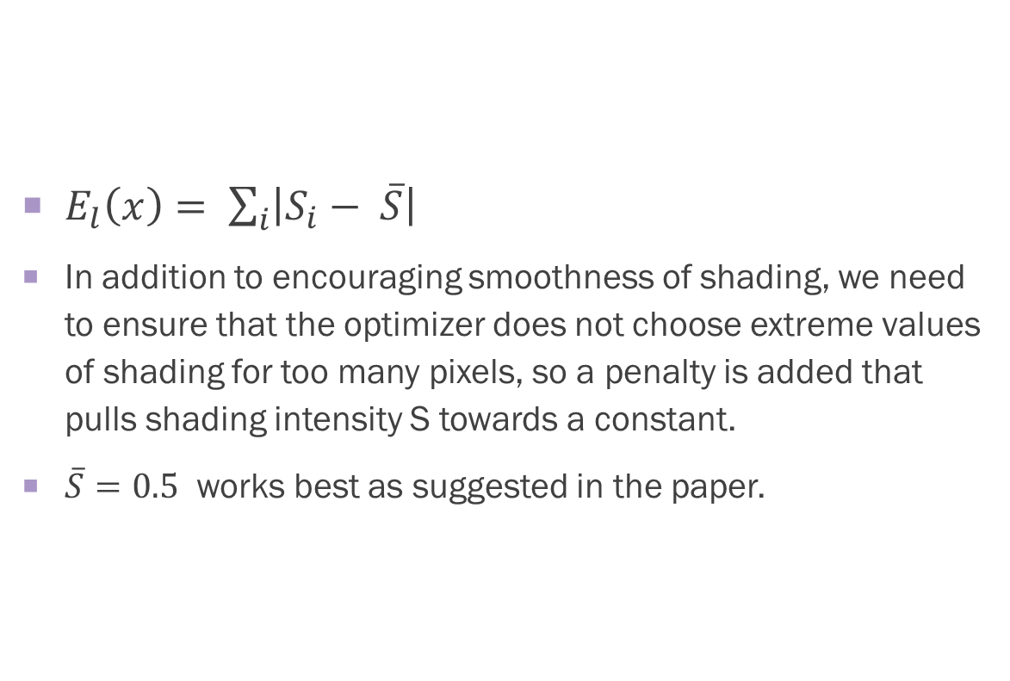

Regularization term $$E_{l}$$
$E_{l}\left(x\right)= \sum_{i}{\left|S_{i}− \overline{S}\right|}$
In addition to encouraging smoothness of shading, we need to ensure that the optimizer does not choose extreme values of shading for too many pixels, so a penalty is added that pulls shading intensity S towards a constant.
$\overline{S}=0.5$ works best as suggested in the paper.

Slide 15
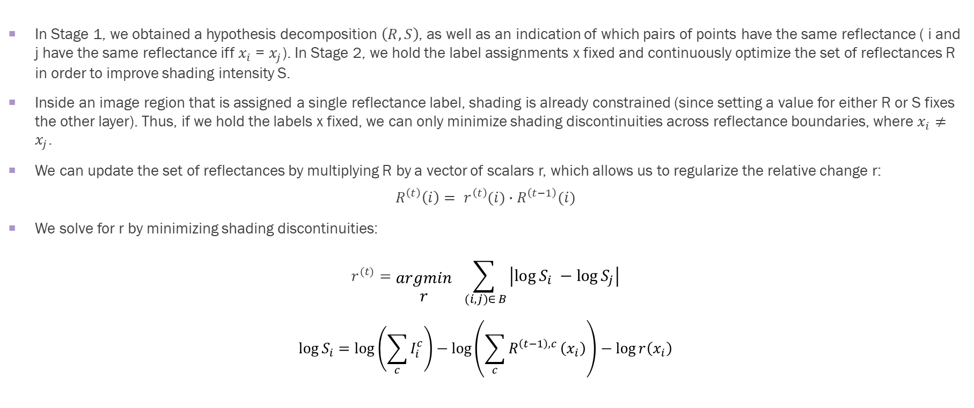
Stage 2 : Shading optimization
In Stage 1, we obtained a hypothesis decomposition $\left(R,S\right)$, as well as an indication of which pairs of points have the same reflectance ( i and j have the same reflectance iff $x_{i}$ = $x_{j}$). In Stage 2, we hold the label assignments x fixed and continuously optimize the set of reflectances R in order to improve shading intensity S.
Inside an image region that is assigned a single reflectance label, shading is already constrained (since setting a value for either R or S fixes the other layer). Thus, if we hold the labels x fixed, we can only minimize shading discontinuities across reflectance boundaries, where $x_{i}≠x_{j}$.
We can update the set of reflectances by multiplying R by a vector of scalars r, which allows us to regularize the relative change r:
$$R^{\left(t\right)}\left(i\right)= r^{\left(t\right)}(i)∙R^{\left(t−1\right)}(i)$$
We solve for r by minimizing shading discontinuities:
$$r^{(t)}=\begin{aligned} \\ argmin \\ r\end{aligned}{ \sum_{ \left(i,j\right)∈ B }{\left|\log{S_{i}} −\log{S_{j}}\right|}}$$
$$\log{S_{i}}=\log\left(\sum_{c}{I_{i}^{c}}\right)−\log\left(\sum_{c}{R^{\left(t−1\right),c}}\left(x_{i}\right)\right)−\log{r\left(x_{i}\right)}$$

Slide 16
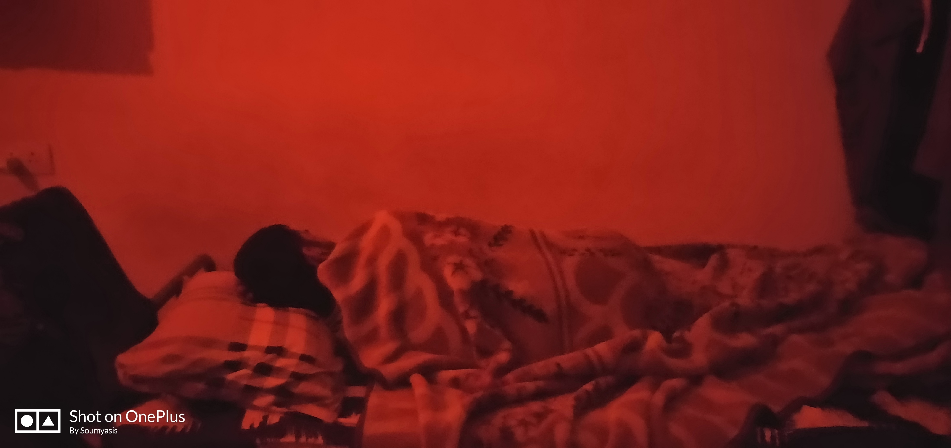

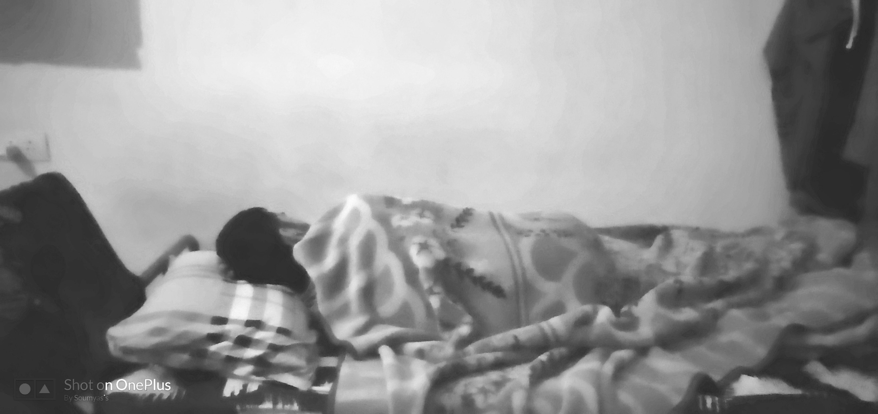
novelty
Priors with colour information:
The priors for shading suggested by the paper uses only grayscale information for shading.
If the lighting isn’t of white colour(or close to white) then the expected reflectance is not achieved.
We tried to incorporate RGB information of source by taking correlation of each channel with every other channel and finding independent probabilities; but failed at implementing it.
Original Image
Achieved Reflectance
Shading Image

Slide 17
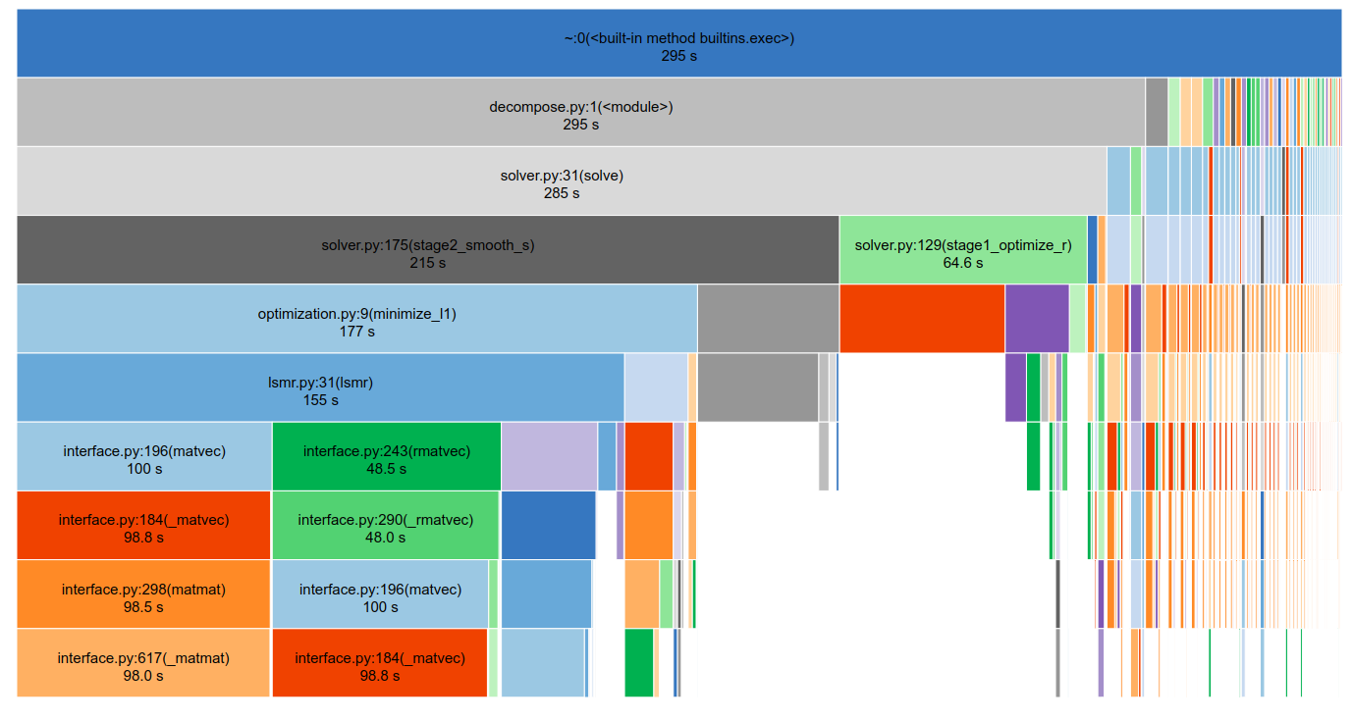
Tried to implement speed-up using numba:
This was done by viewing the memory stack of each file via snakeviz visualization.
This novelty couldn’t be completed due to problems with jit class of numba and driver issues with CUDA.
An additional way this speed up could be targeted is using multi-core CPU threading using LLVM. However due to time constraints we have put it as a future objective.
Memory Stack

Slide 18
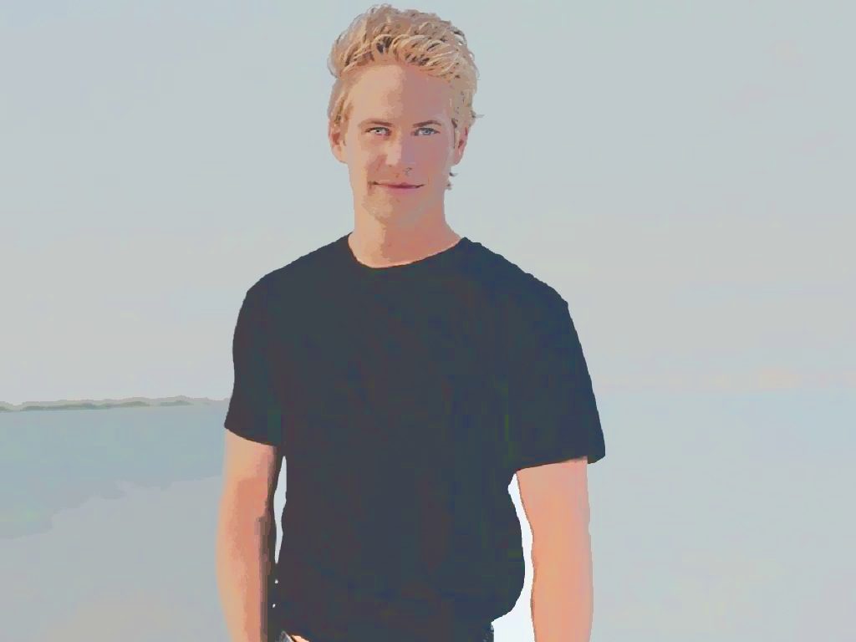
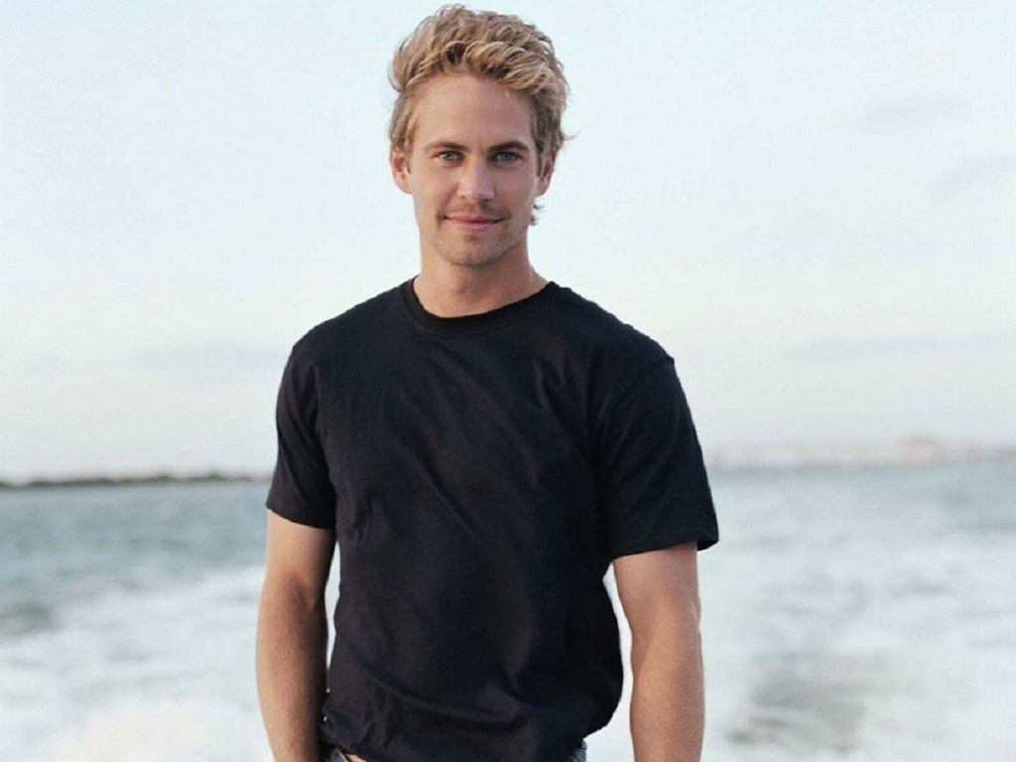
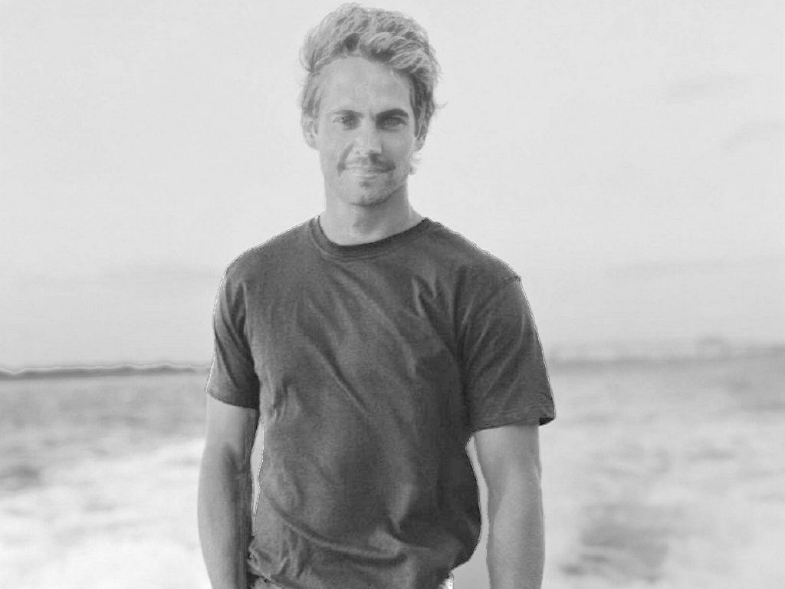
results

Slide 19
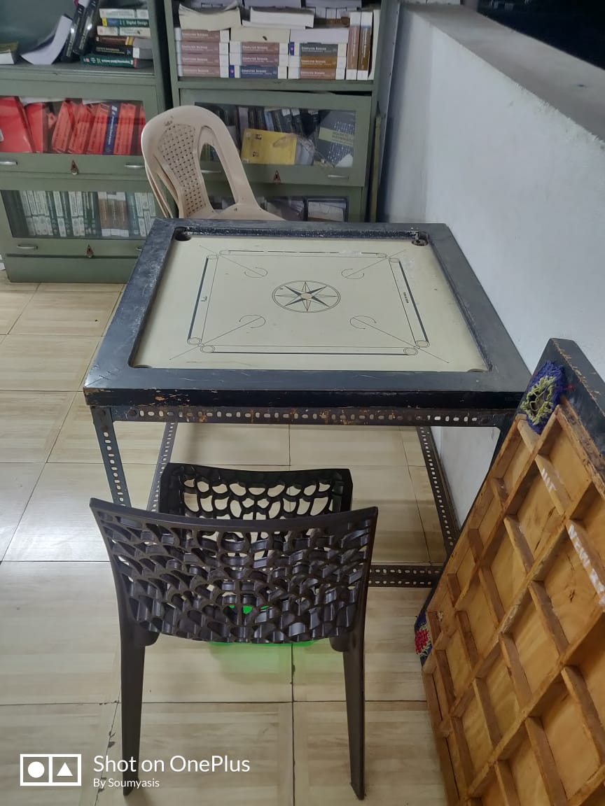
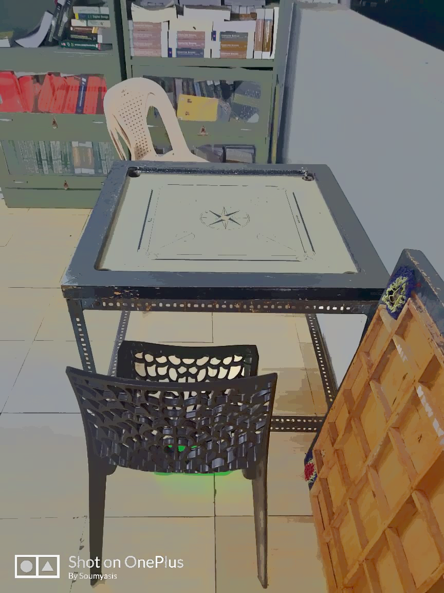
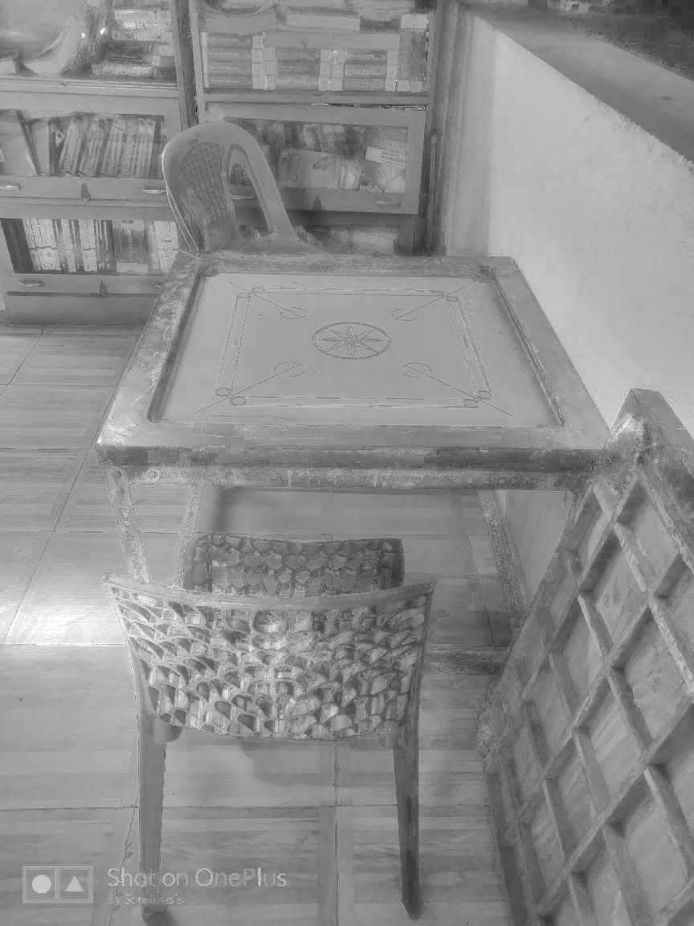
Original Image
Reflectance Image
Shading Image

Slide 20
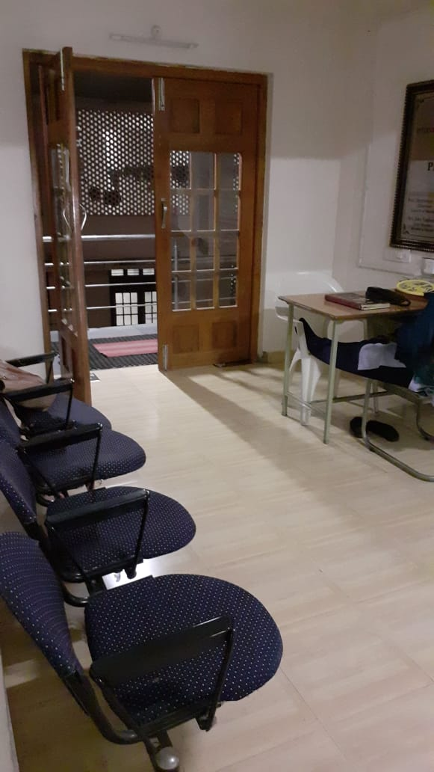
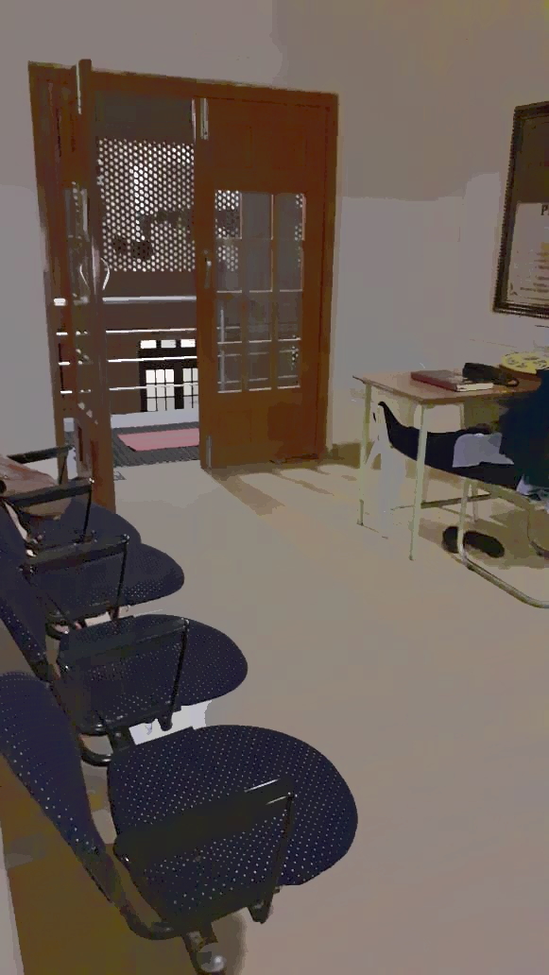
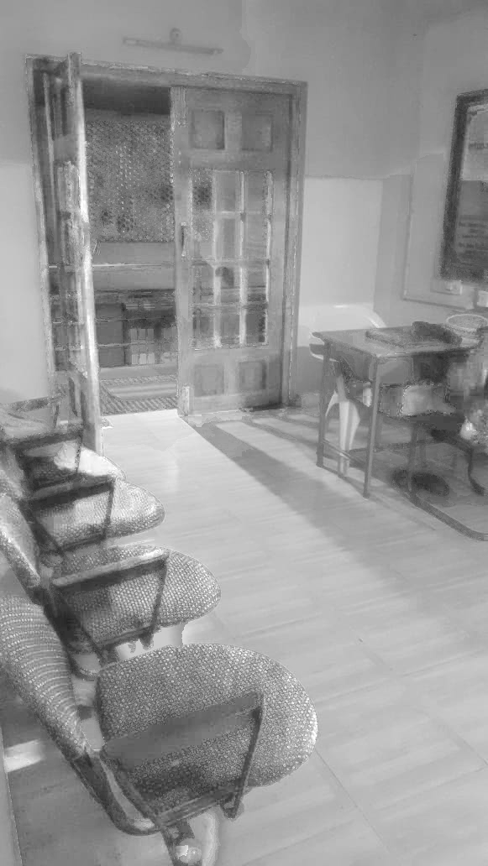
Original Image
Reflectance Image
Shading Image

Slide 21
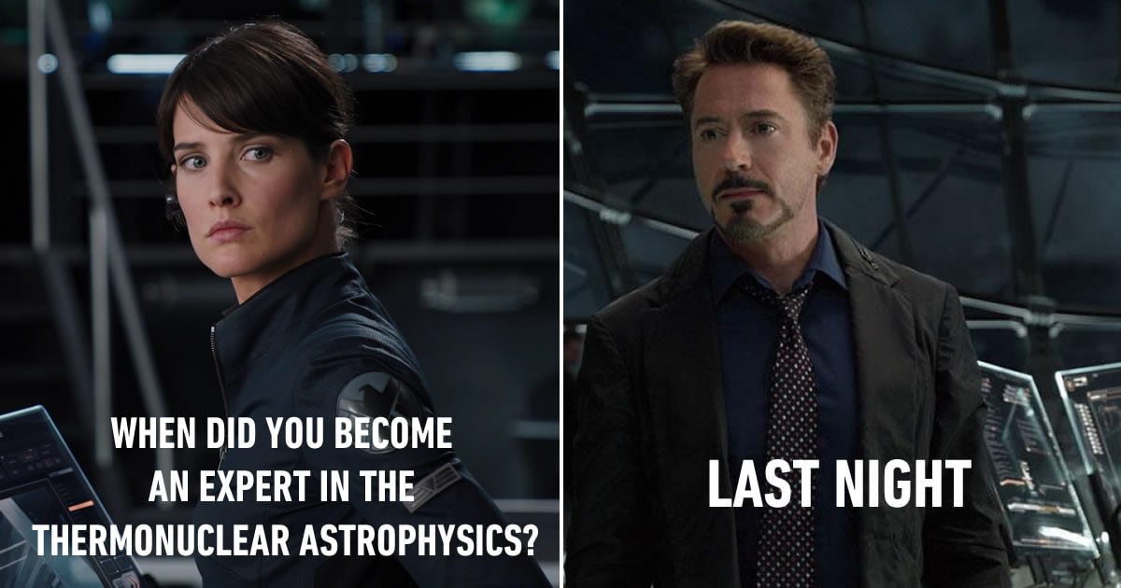

Slide 22
Work division
Saumya :
Dataset Management
Histogram of probability density class.
Update parameters.
Obtain judgement parameters for opensource dataset.
Aniket :
L1 and L2 optimisation for minimizing shading discontinuities.
Created wrapper for DenseCRF [from Krahenbuhl].
Integrated cpp files.
Soumyasis :
Documentation.
Created function for image interface.
Algorithm initialization.
Repaired the energy function.
Combined work:
Saumya and Soumyasis :
Built solver class
Aniket and Soumyasis :
Energy function optimizer for stage 1
All together : Debugging

Slide 23
Thank you

